Slide 1

Class21
CSC 495/583 Topics of Software Security Heap Exploitation (2): Unlink, House of Force
Dr. Si Chen (schen@wcupa.edu)

Slide 2
Pseudo Memory Map
0x00000000 – Start of memory
0x00000000 – Start of memory
Runtime Memory
Libraries (libc)
ELF Executable
.text segment
.data segment
Heap
Stack
Runtime Memory
Libraries (libc)
ELF Executable
.text segment
.data segment
Heap
Stack
0x08048000 – Start of .text Segment
0x08048000 – Start of .text Segment
0xb7ff0000 – Top of heap
0xbfff0000 – Top of stack
0xFFFFFFFF – End of memory
MBE - 04/07/2015
2

Slide 3
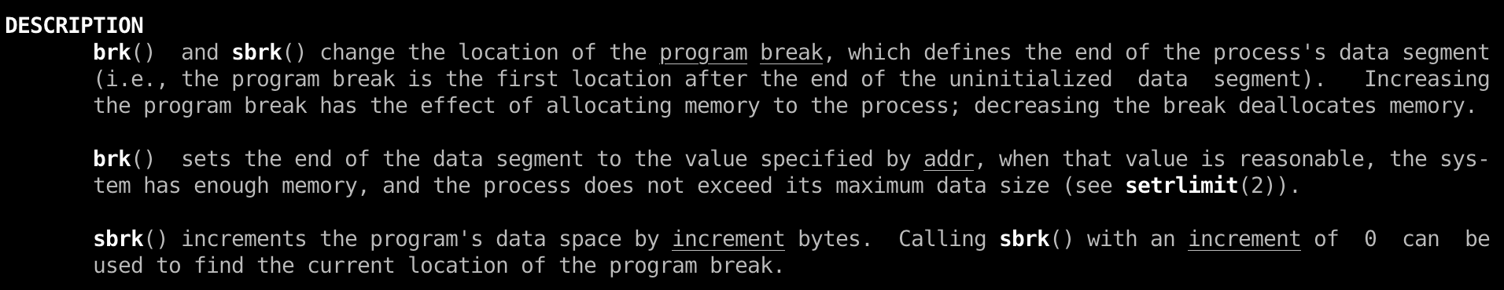
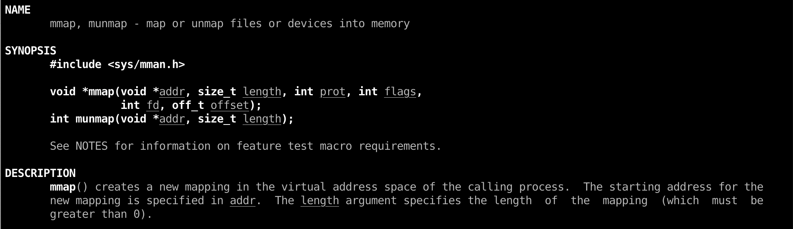
Heap in Linux (GNU C Library – glibc)
ptmalloc2
System call:
brk()
mmap()

Slide 4
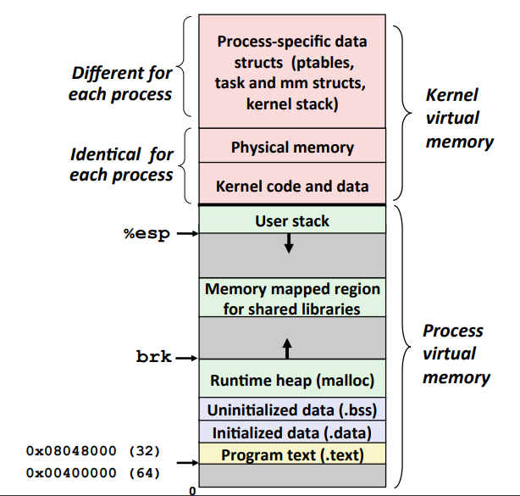
The Heap

Slide 5
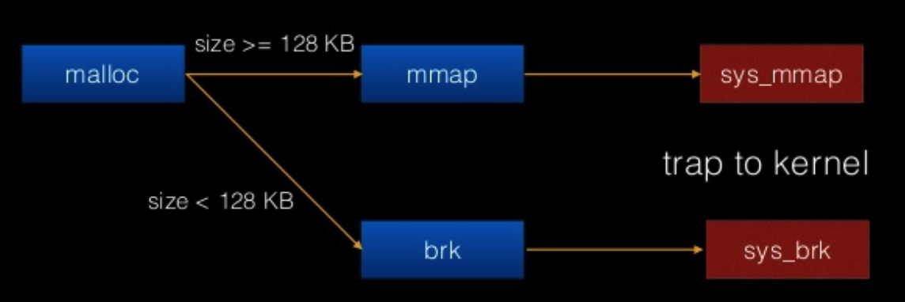
The workflow of malloc()

Slide 6
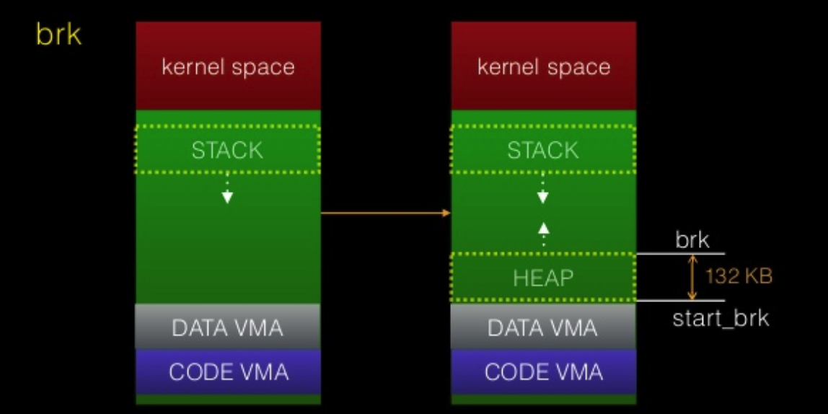
The workflow of malloc()
If malloc size < 128KB then Kernel will return a 132KB heap segment (rw)
which called main arena

Slide 7
glibc source code
https://code.woboq.org/userspace/glibc/malloc/malloc.c.html

Slide 8
Bins and Chunks
A bin is a list (doubly or singly linked list) of free (non-allocated) chunks. Bins are differentiated based on the size of chunks they contain:
Fast bin
Unsorted bin
Small bin
Large bin

Slide 9
Doug Lea‘s malloc Heap Chunks
Heap chunks exist in two states
in use (malloc’d)
free’d

Slide 10
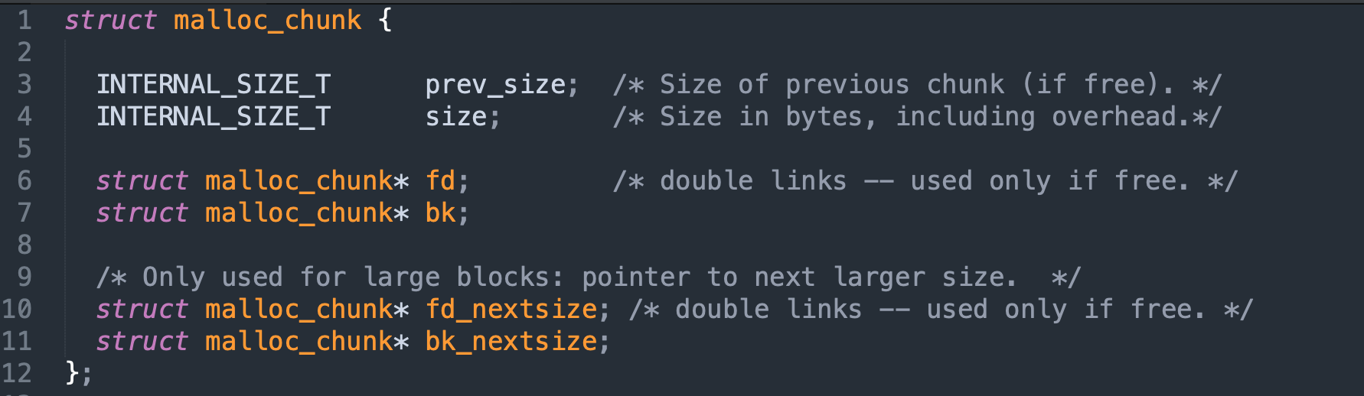
malloc chunk

Slide 11
Heap Chunks – Freed
unsigned int * buffer = NULL; buffer = malloc(0x100);
free(buffer);
Forward Pointer
A pointer to the next freed chunk
Backwards Pointer
A pointer to the previous freed chunk
Heap Chunk (freed)
Previous Chunk Size (4 bytes)
Chunk Size (4 bytes)
Flags
FD
(4 bytes)
BK
(4 bytes)
*(buffer-2)
*(buffer-1)
*buffer
*(buffer+1)

Slide 12
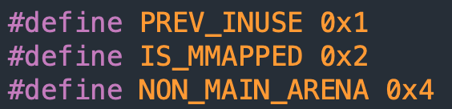
Heap Chunks
unsigned int * buffer = NULL; buffer = malloc(0x100);
//Out comes a heap chunk
Heap Chunk
Previous Chunk Size (4 bytes)
Chunk Size (4 bytes)
Flags
Data
(8 + (n / 8)*8 bytes)
*(buffer-2)
*(buffer-1)
*buffer

Slide 13
Heap Allocations
0x00000000
Runtime Memory
Libraries (libc)
ELF Executable
.text segment
.data segment
Heap
Stack
Heap Segment
Grows towards higher memory
--------------------------------->
Previous Chunk Size
Chunk Size
Data
0xFFFFFFFF

Slide 14
Heap Allocations
0x00000000
Runtime Memory
Libraries (libc)
ELF Executable
.text segment
.data segment
Heap
Stack
Heap Segment
Grows towards higher memory
--------------------------------->
Previous Chunk Size
Chunk Size
Data
Previous Chunk Size
Chunk Size
Data
0xFFFFFFFF

Slide 15
Heap Allocations
0x00000000
Runtime Memory
Libraries (libc)
ELF Executable
.text segment
.data segment
Heap
Stack
Heap Segment
Grows towards higher memory
--------------------------------->
Previous Chunk Size
Chunk Size
Data
Previous Chunk Size
Chunk Size
Data
Previous Chunk Size
Chunk Size
Data
0xFFFFFFFF

Slide 16
Heap Overflows
0x00000000
Runtime Memory
Libraries (libc)
ELF Executable
.text segment
.data segment
Heap
Stack
Heap Segment
Grows towards higher memory
--------------------------------->
Previous Chunk Size
Chunk Size
Data
Previous Chunk Size
Chunk Size
Data
Previous Chunk Size
Chunk Size
Data
0xFFFFFFFF

Slide 17
Heap Overflows
Buffer overflows are basically the same on the heap as they are on the stack
0x00000000
Runtime Memory
Libraries (libc)
ELF Executable
.text segment
.data segment
Heap
Stack
Heap Segment
Grows towards higher memory
--------------------------------->
Previous Chunk Size
Chunk Size
AAAAAAAAAAAAAA AAAAAAAAAAAAAA AAAAAAAAAAAAAA AAAAAAAAAAAAAA AAAAAAAAAAAAAA … heap overflow
Previous Chunk Size
Chunk Size
Data
Previous Chunk Size
Chunk Size
Data
0xFFFFFFFF

Slide 18
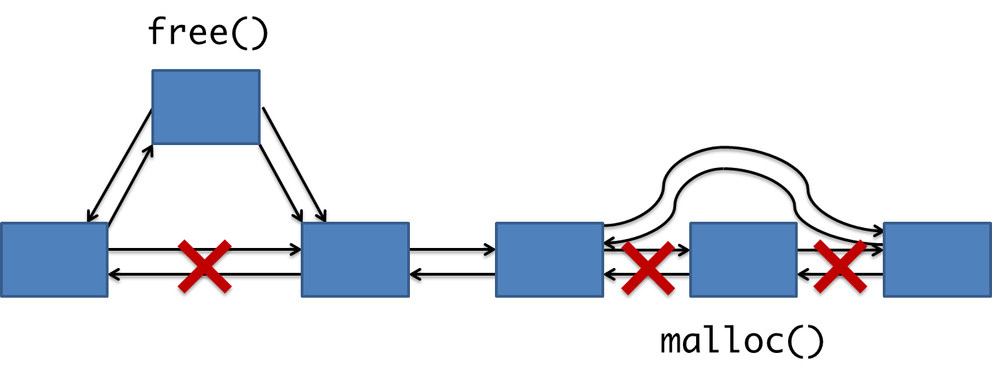
malloc & free

Slide 19
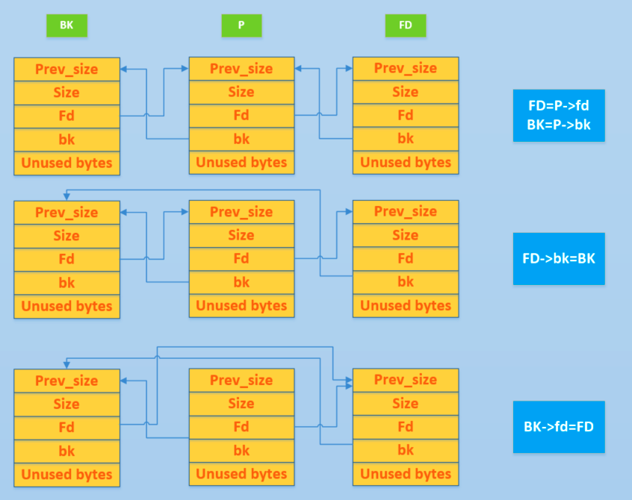
Unlink

Slide 20
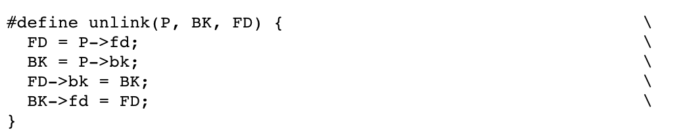
Unlink
remove a chunk from linked list

Slide 21
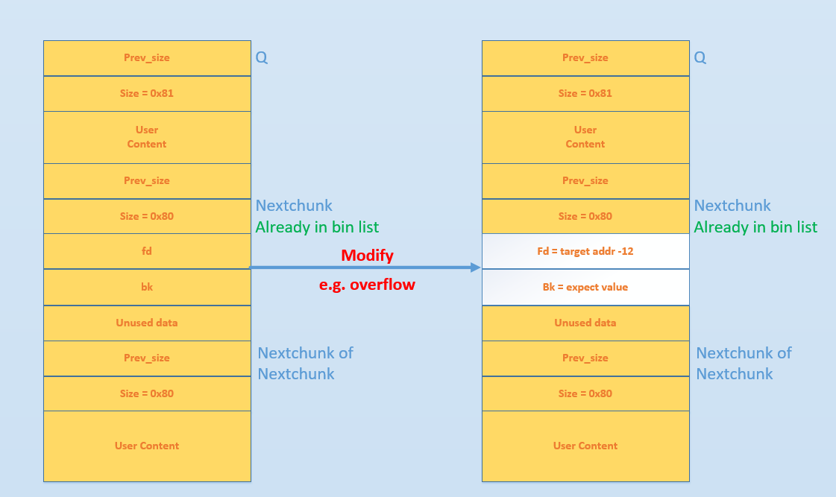
(Old) Unlink Attack
In Use: Q
Freed: Nextchunk
free(Q);

Slide 22
(Old) Unlink Attack
FD = P-> fd = target addr – 12 FD->bk = BK which is *(target addr – 12 + 12) = BK = expect value
BK = P->bk = expect value BK-> fd = FD which is *(expect value + 8) = FD = target addr - 12

Slide 23
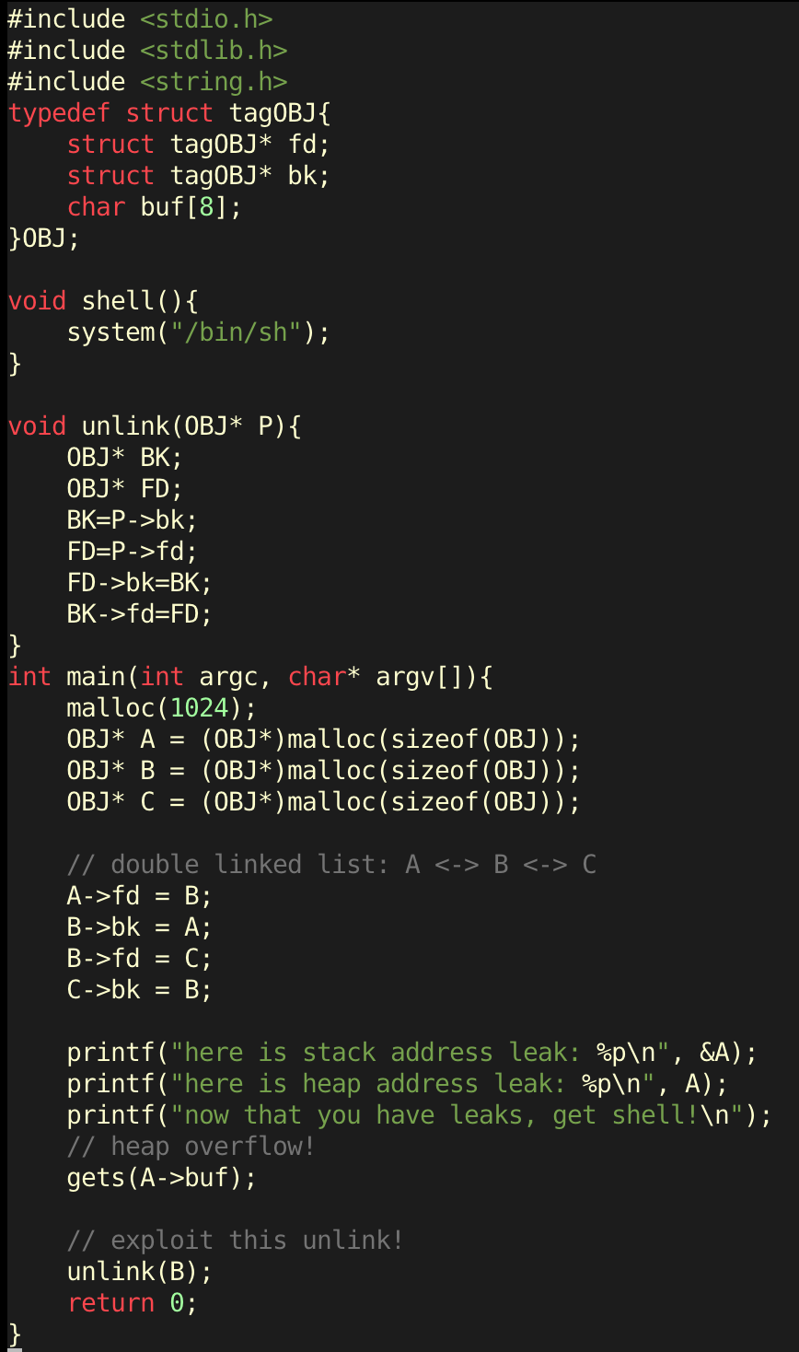

Unlink Exercise

Slide 24
Initial Idea
Fd → Unlink() Return Address
Bk → shell() address

Slide 25
Initial Idea
FD = P-> fd = target addr – 12 FD->bk = BK which is *(target addr – 12 + 12) = BK = expect value
BK = P->bk = expect value BK-> fd = FD which is *(expect value + 8) = FD = target addr - 12
Fd → Unlink() Return Address
Bk → shell() address
Shell() has been changed!

Slide 26

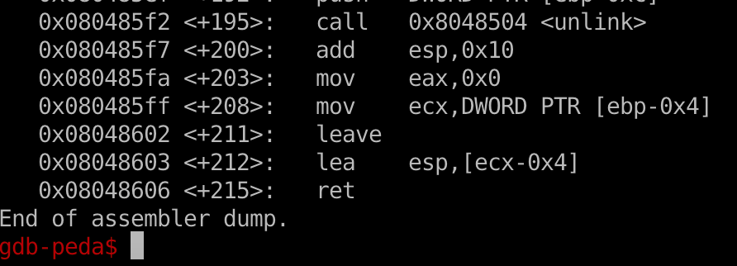
Solution
ret --> set EIP value as ESP
lea esp, [ecx-0x4] → put [ecx-0x4] to esp
mov ecx, DWORD PTR [ebp-0x4] → put [ebp-0x4] to ecx

Slide 27
Solution
ret --> set EIP value as ESP
lea esp, [ecx-0x4] → put [ecx-0x4] to esp
mov ecx, DWORD PTR [ebp-0x4] → put [ebp-0x4] to ecx
set [ecx-0x4] == shell() addr
→ set ecx == shell() addr + 4
--> set [ebp-0x4] == shell() addr + 4

Slide 28
Solution
Shellcode structure:
shell() address + dummy characters + Fd + Bk
malloc(sizeof(OBJ)) → 8 * (int (4 + 4 + 8 + 4) / 8 +1) = 24
24 byte = 4 byte (Previous Chunk Size) + 4 byte (chunk Size) + 16 byte Data

Slide 29
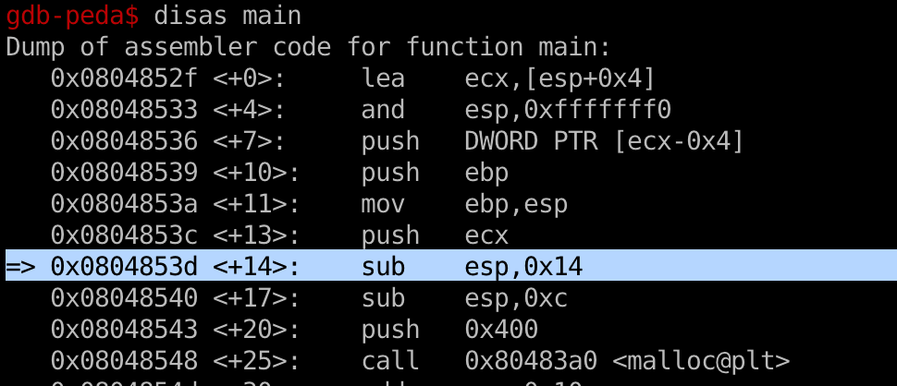
Solution
sub esp, 0x14 → ebp = esp + 14
→ ebp – 4 = esp + 10

Slide 30
Solution
Shell() addr + 4 == heap_leak + 8 + 4
= heap_leak + 0xc

Slide 31
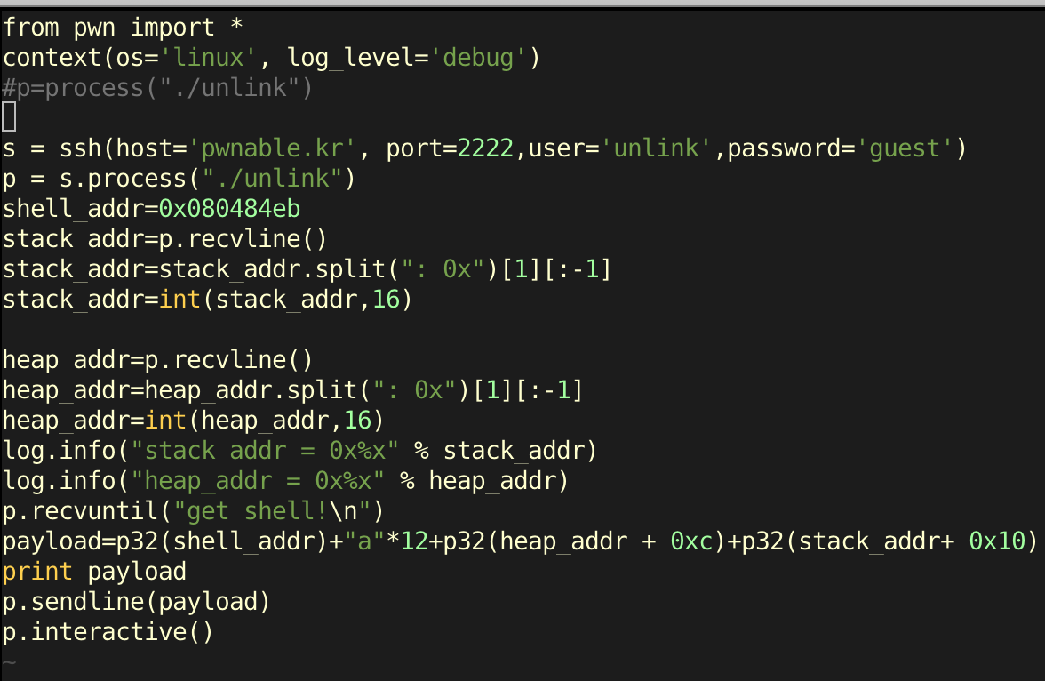

Slide 32
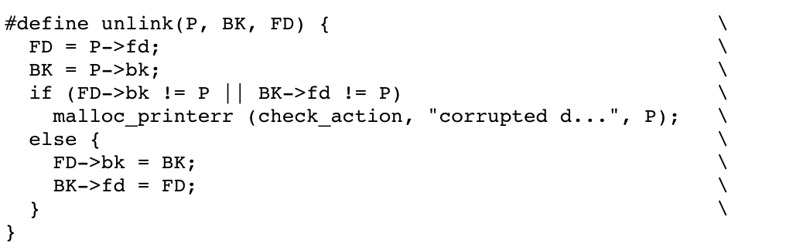
The truth

Slide 33
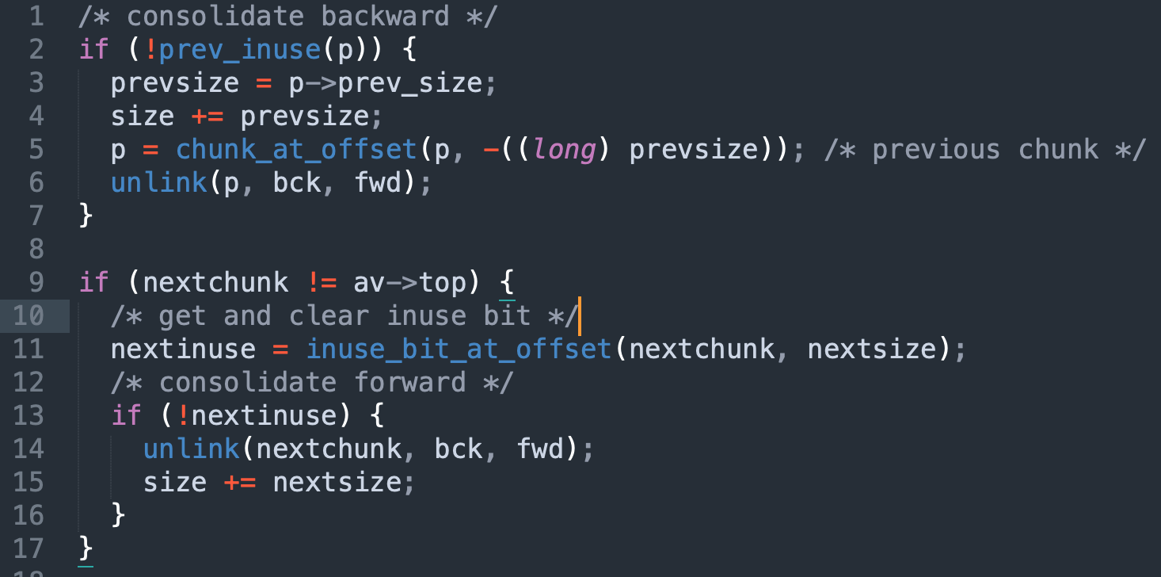
Consolidate Free Chunk

Slide 34
House of Force
House of Force: In this technique, attacker abuses top chunk size and tricks ‘glibc malloc’ to service a very large memory request (greater than heap system memory size) using top chunk. Now when a new malloc request is made, GOT entry of free would be overwritten with shellcode address. Hence from now on whenever free is called, shellcode gets executed!!

Slide 35
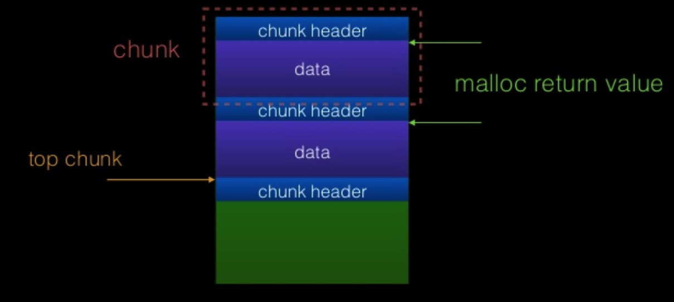
Mechanism of glibc malloc
Allocated chunk
Free chunk
Top chunk

Slide 36
Top Chunk
Top Chunk: Chunk which is at the top border of an arena is called top chunk. It doesn't belong to any bin. Top chunk is used to service user request when there is NO free blocks, in any of the bins. If top chunk size is greater than user requested size top chunk is split into two:
User chunk (of user requested size)
Remainder chunk (of remaining size)
The remainder chunk becomes the new top. If top chunk size is lesser than user requested size, top chunk is extended using sbrk (main arena) or mmap (thread arena) syscall.

Slide 37
The Malloc Maleficarum (2004)
The Malloc Maleficarum
In late 2001, "Vudo Malloc Tricks" and "Once Upon A free()" defined the exploitation of overflowed dynamic memory chunks on Linux.
In late 2004, a series of patches to GNU libc malloc implemented over a dozen mandatory integrity assertions, effectively rendering the existing techniques obsolete.
It is for this reason, a small suggestion of impossibility, that they present the Malloc Maleficarum:
The House of Prime
The House of Mind
The House of Force
The House of Lore
The House of Spirit
The House of Chaos

Slide 38
The Malloc Maleficarum (2004)
The Malloc Maleficarum
In late 2001, "Vudo Malloc Tricks" and "Once Upon A free()" defined the exploitation of overflowed dynamic memory chunks on Linux.
In late 2004, a series of patches to GNU libc malloc implemented over a dozen mandatory integrity assertions, effectively rendering the existing techniques obsolete.
It is for this reason, a small suggestion of impossibility, that they present the Malloc Maleficarum:
The House of Prime
The House of Mind
The House of Force
The House of Lore
The House of Spirit
The House of Chaos
https://dl.packetstormsecurity.net/papers/attack/MallocMaleficarum.txt

Slide 39
House of Force

Slide 40
House of Force
This attack assumes an overflow into the top chunk's header. The size is modified to a very large value (-1 in this example).
This ensures that all initial requests will be services using the top chunk, instead of relying on mmap.
On a 64 bit system, -1 evaluates to 0xFFFFFFFFFFFFFFFF.
A chunk with this size can cover the entire memory space of the program.

Slide 41
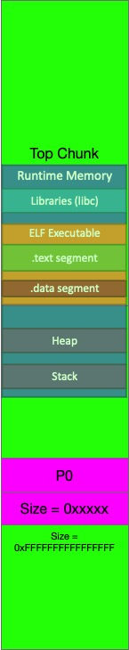
House of Force
Let us assume that the attacker wishes 'malloc' to return address P. Now, any malloc call with the size of: &top_chunk - P will be serviced using the top chunk. Note that P can be after or before the top_chunk.

Slide 42
House of Force
Prerequisites: Three malloc calls are required to successfully apply house of force as listed below:
Malloc 1: Attacker should be able to control the size of top chunk. Hence heap overflow should be possible on this allocated chunk which is physically located previous to top chunk.
Malloc 2: Attacker should be able to control the size of this malloc request.
Malloc 3: User input should be copied to this allocated chunk.

Slide 43
Exercise: BambooBox
Source Code:
https://github.com/ctf-wiki/ctf-challenges/blob/master/pwn/heap/house-of-force/hitcontraning_lab11/bamboobox.c
Solution:
https://github.com/ctf-wiki/ctf-challenges/blob/master/pwn/heap/house-of-force/hitcontraning_lab11/exp.py

Slide 44
First-fit behavior
This technique describes the 'first-fit' behavior of glibc's allocator.
Whenever any chunk (not a fast chunk) is freed, it ends up in the unsorted bin.
Insertion happens at the HEAD of the list.
On requesting new chunks (again, non fast chunks), initially unsorted bins will be looked up as small bins will be empty.
This lookup is from the TAIL end of the list. If a single chunk is present in the unsorted bin, an exact check is not made and if the chunk's size >= the one requested, it is split into two and returned. This ensures first in first out behavior.

Slide 45
Q & A

